Slide 1
Semantic Analysis of Comments
Mernegar Dorgoly

Slide 2
Profanity Vs. Free speech
Discussing things you care about can be difficult. The threat of abuse and harassment online means that many people stop expressing themselves and give up on seeking different opinions.
The need for fostering a safe and healthy environment for conversations is so crucial yet challenging that some platforms rather limit or completely shut down user comments if they can’t facilitate a safe environment.
In this project, the challenge is to build model(s) that are capable of detecting the correct label (Offensive or non-offensive) for the comments in the dataset.

Slide 3


Slide 4
Challenges:
This dataset like any other real-world data is messy and far from perfect. Below is a list if problems needed to get addressed during the wrangling and pre-processing the text:
Spelling errors
Use of special characters such as $, %, !, @, /…
Mixed use of Lower and Upper cases in words and sentences
Text message abbreviations like JK (joking), JP (just playing), JT (just teasing) ,2morow(tomorrow), 2night(tonight), AAP(always a pleasure), AAF( as a friend), AAR8(at any rate), AAYF(always your friend), ACC(anyone can come), ATM(At the moment)can’t be decoded

Slide 5
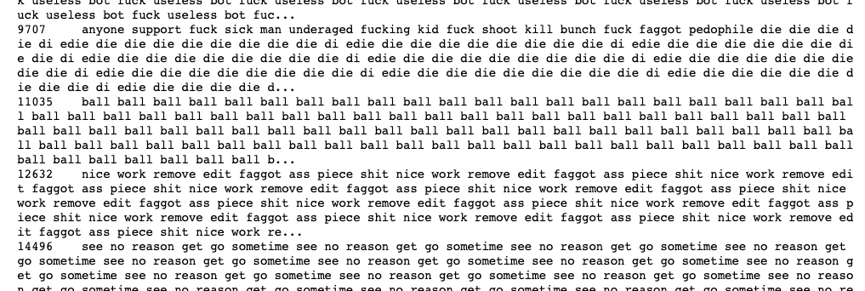
Challenges:
Outliers: Comments longer than 500 words were considered as 500. Exploring them showed interestingly these comments are multiple copies of one phrase or sentence.

Slide 7
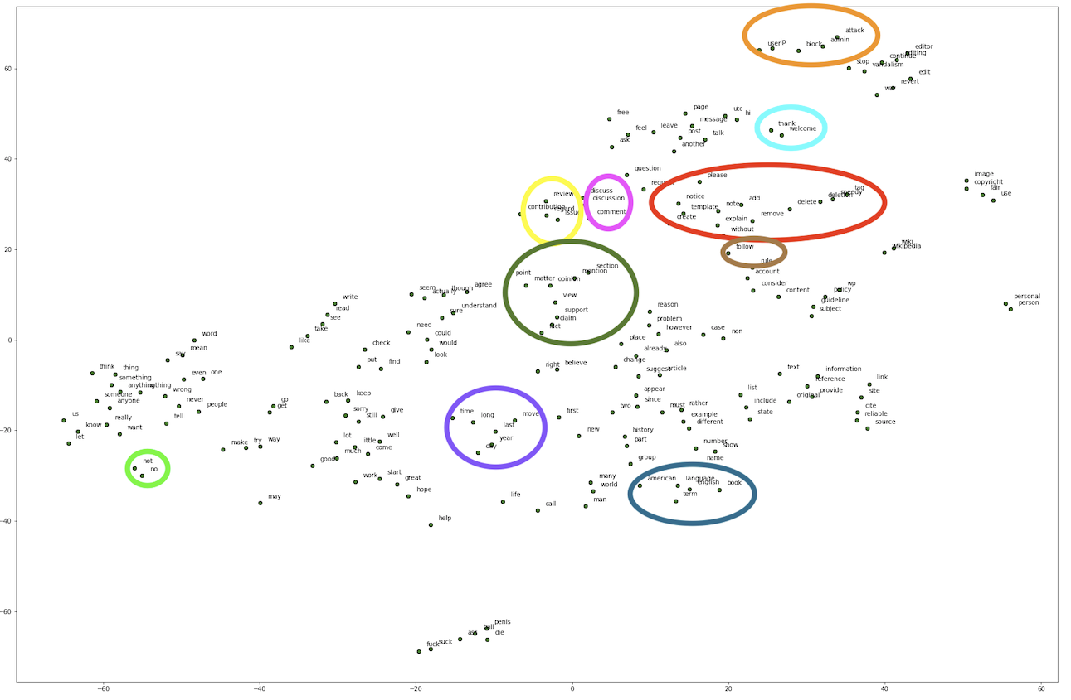
Word2Vec Vs. FastText

Slide 8
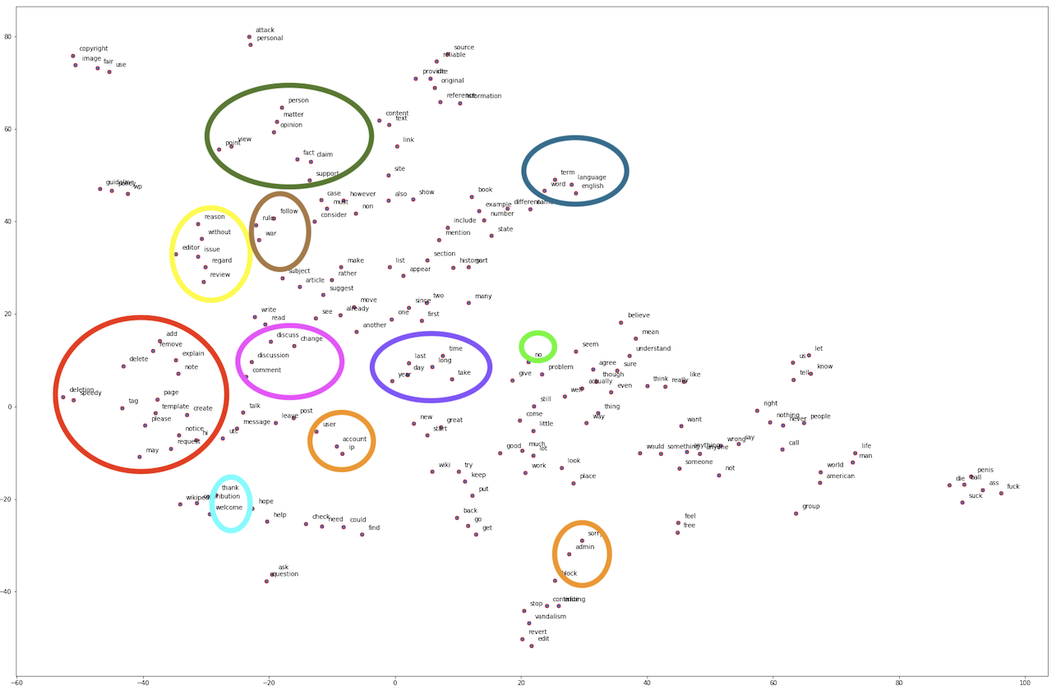
Word2Vec Vs. FastText

Slide 9
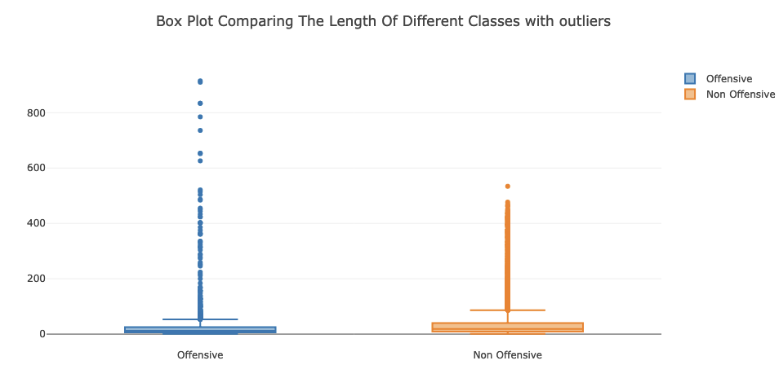
Exploratory Data Analysis (EDA):

Slide 10
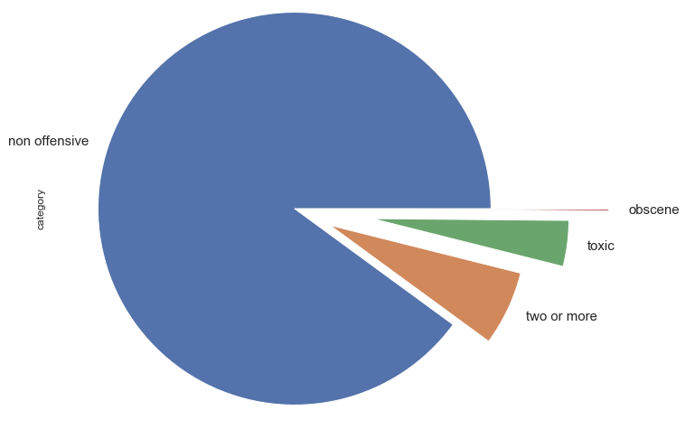
Exploratory Data Analysis (EDA):

Slide 11
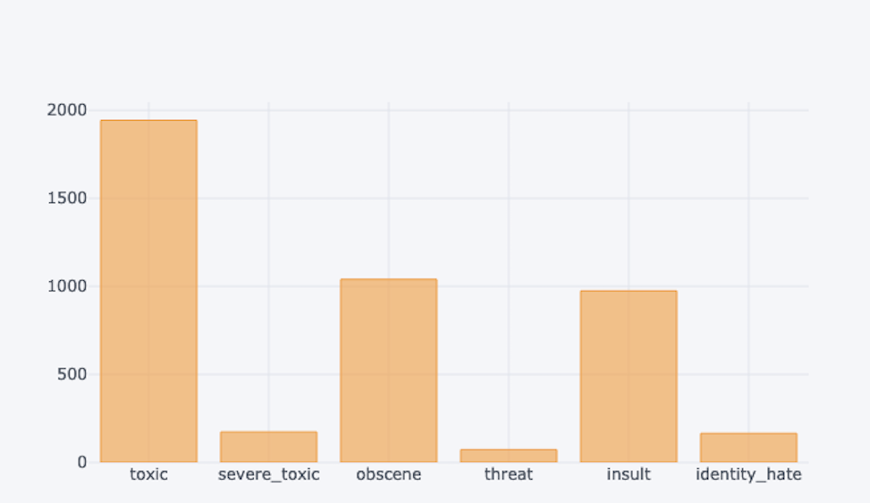
Exploratory Data Analysis (EDA):

Slide 12


Slide 13
Offensive or Non-Offensive:
When we deal with an imbalance dataset accuracy is not the most reliable metric for evaluating the classifier. In this project like similar classification problem with imbalanced classes we need to evaluate models based on number of False Negatives and False Positive.
The goal of this project is to detect and flag comments with offensive content. According to our business plan, these flagged comments will be sent to the review team for detailed review. For our business it’s important to catch as many offensive comments as possible, the cost of missing an offensive comment is more than the cost of further review. So, due to the nature of this problem our focus is on reducing number of False Negatives as much as possible.
Recall is a metric that measure rate of true positive to the total number of predicted positives. Due to the nature of this problem it would be the most appropriate metric for evaluating performance of different models for this dataset.

Slide 14
Traditional Machine Learning
In order to find the most optimized model, we started with training some traditional machine learning algorithms such as “Logistic Regression, SMOTE, Naive Bayes, Random Forest and XGBoost” and tuned the hyper-parameters for each model via RandomizedSearchCV/ GridSearchCV to train the best classifier for the model. The best results were obtained from SMOTE followed by Naive Bayes.
The next step was to stack the optimized models and trained them on Bag Of Words and TF-IDF to see if we can get a better result from combined models. Recall results improved by 19.5% and we experienced the least number of False Negatives.

Slide 15
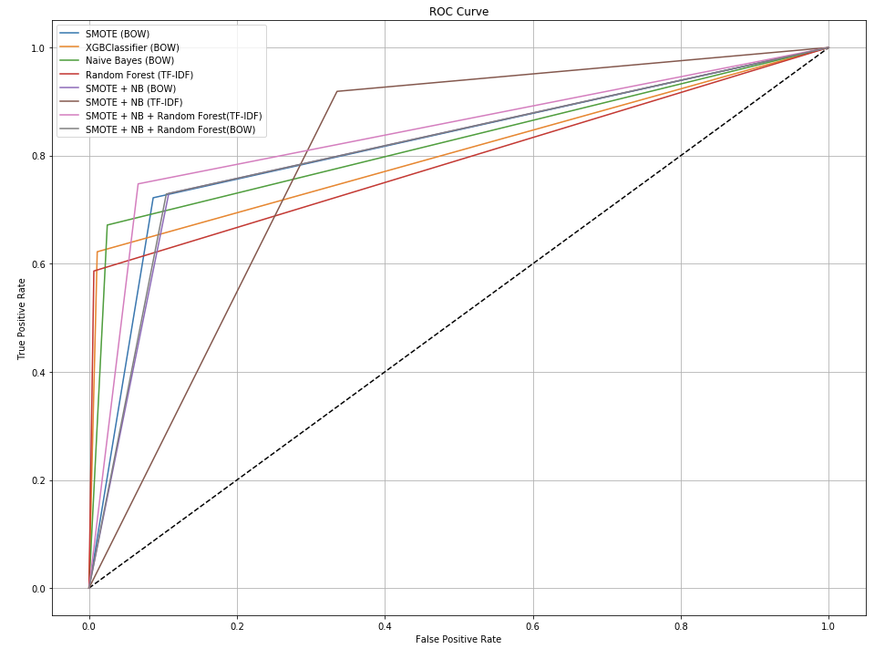

Slide 16
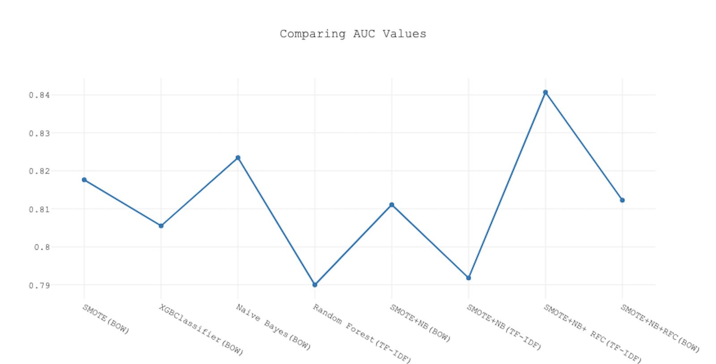

Slide 17
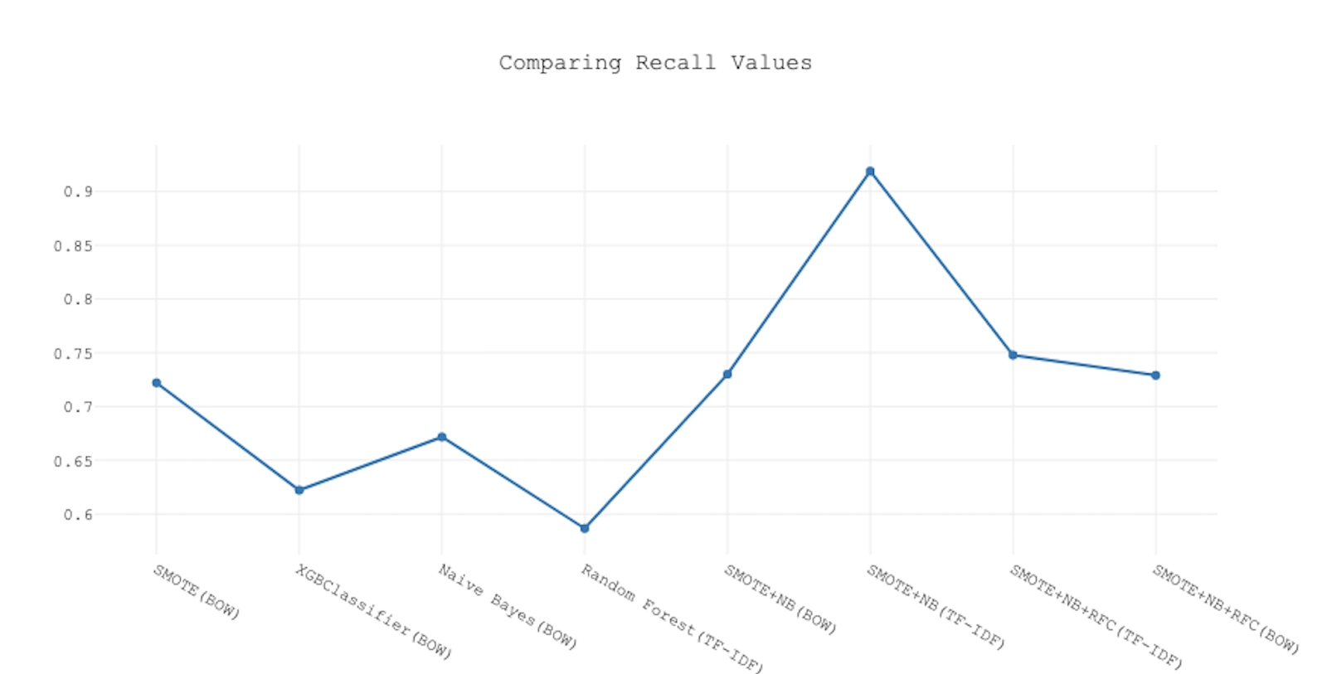

Slide 18


Slide 19
Deep Neural Network
Created a Sequential model with 6 hidden layers and trained it on the averaged word vector of features from word2vec model. We created different versions of the model by choosing different:
Optimizers: “adam” and “tanh”
“Batch_size” and “epochs”
Neurons for each layer: 64 , 128
Even though the overall accuracy was around 93%, but the high number of False Negatives showed our model and different variation of it are not good classifiers compare to some of traditional models.

Slide 20
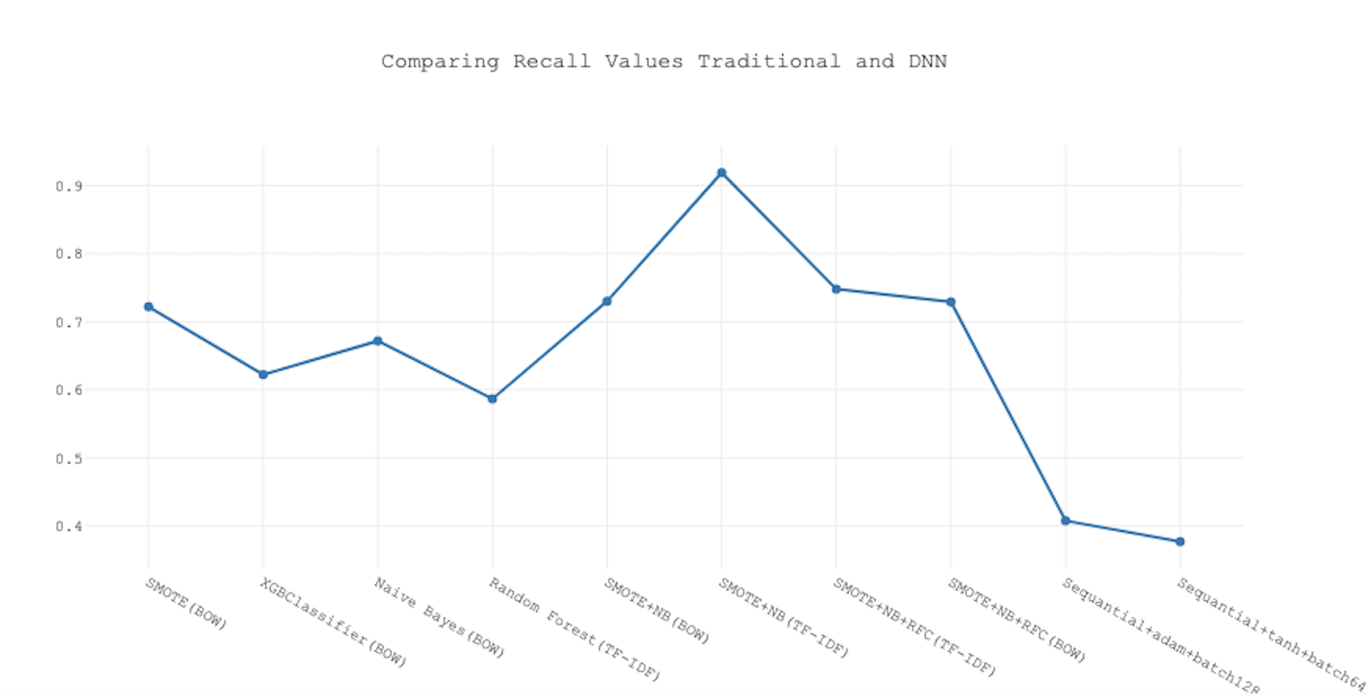

Slide 21
CONCLUSION

Slide 22
Conclusion
In order to evaluate the performance of imbalanced datasets it’s not enough to rely solely on accuracy, depending on the problem we should focus on False Negatives or False Positives. In this project goal is reduce the number of False Negatives as much as possible or get the highest possible value for recall.
After Optimizing different machine learning models such as Logistic Regression, SMOTE, Naive Bayes and Random Forest via RandomSearch CV and GridSearchCV we took one step further and combined the optimized models to see if we possibly can improve the value of Recall metric. The combined model of SMOTE and Naive Bayes on TF-IDF generated the best possible Recall of almost 92% and only misclassified 82 offensive comments as non-offensive.

